Slide 1
Credit One Report
Alex Guevara

Slide 2
Objectives
Use BADIR data science process framework
Define Credit One business question and stakeholders
Consider business impact of key features influencing default status
Establish a timeline and available project resources
Outline Analysis Plan for Credit One
Process and analyze data collected over 6 month period
Highlight Future Insights
Provide Credit One best recommendations based on project findings

Slide 3
BADIR Framework
B
Business Question & Impact, Stakeholders, Timeline
A
Analysis Plan & Methodologies
D
Data Collection, Processing & Analysis
I
R
Insights
Recommendations

Slide 4
Credit One Business Question
Credit One notes the negative business impact of increasing loan defaults secondary to credit limits that may be too high for a portion of their consumers.
How can Credit One improve threshold credit limits for its customers to prevent defaulting loans therefore improving greater ROI?
Notes:
Business question
What is the stated business question?
What is the intent underlying the question (e.g., what is the context, what is the impacted segment, and what are stakeholders’ current thoughts about the underlying reasons?
What business considerations (e.g., stakeholders, timeline, and cost) are likely to impact the analysis?
Stakeholders time (meetings)
Analysis Time

Slide 5
Stakeholders
Key Stakeholders
Credit One (CEO, CFO, Marketing Managers)
Loan Servicing Partners
Bulldog Consulting LLC Team
Ancillary Stakeholders
Consumers (primary users)

Slide 6
Business Impact
Considerations that may impact Credit One default status over a 6 month time period
Gender
Education levels
Marital status
Age (21-75)
Consumer purchasing versus payment patterns
Credit repayment patterns
non-consumption, payment in full, revolving credit, delayed payments
Notes:
Business question
What is the stated business question?
What is the intent underlying the question (e.g., what is the context, what is the impacted segment, and what are stakeholders’ current thoughts about the underlying reasons?
What business considerations (e.g., stakeholders, timeline, and cost) are likely to impact the analysis?
Gender (male vs female)
Education levels (graduate school, university, high school, and other)
Marital status (married, single, divorced, other)
Age (21-75)
Consumer purchasing versus payment patterns
Credit repayment patterns (non-consumption, payment in full, revolving credit, delayed payments)

Slide 7
Timeline
Business Plan
2 weeks
Data Analysis
2 months
Implementation
3 months
What are the available project plan resources?
Timeline (Gantt Chart & Roadmap)
Budgeting
Communication Platform with Key Stakeholders
Workflow (Jira & Prioritization Matrix)
Notes:
Gantt Chart

Slide 8
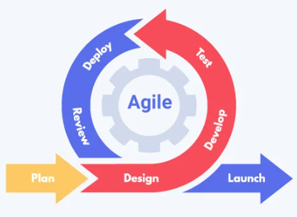
Credit One Analysis Plan
To determine appropriate credit limits based on personal consumer credit factors we will test the following hypotheses
Do younger credit consumers default at higher credit limits?
Is credit limit adjusted based on
Education level
Age
Credit re-payment patterns
Methodologies
Regression testing
Machine Learning & Modeling
Agile
Controlling & Monitoring process

Slide 9
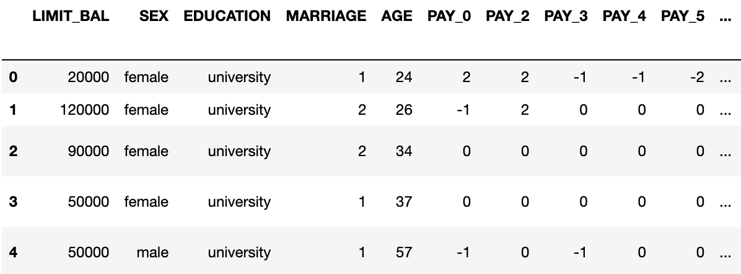
Data Collection
Credit One Data collected between April 2022-September 2022

Slide 10
Data Processing & Analysis
Clean and Transform the Data into a usable format
Discover trends and patterns
Check assumptions
Summarize the data by plotting trends and patterns
Histograms
Scatterplots
Other visualizations

Slide 11
Credit One Project Insights
What patterns do you see in the data?
Are each of the hypotheses proven or disproven?
How much confidence should stakeholders place in the results?
How do you rank your findings in terms of quantified impact on Credit One?

Slide 12
Recommendations for Credit One
Notes:
How can you most effectively present the results of your analysis to your stakeholders (in terms they can understand and in alignment with information they’ll value)?
Objective
Background (optional)
Scope (optional)
Approach (optional)
Recommendations
Key insights with impact
Next steps

Slide 13
END PRESENTATION EXTRA C2T1 BELOW

Slide 14
Preprocessing & EDA
Data cleaning
Convert to csv, labeling
Data transformation
Convert data types
Data reduction
Drop duplicates, drop na, isnull
Data discretization
Text cleaning
Normalization (capitals, misspellings, names)
Matching counts
Summarizing Data
Descriptive statistics (mean, median, min, max, std)
Outliers (quantiles)
Boxplots
Plotting
Histograms
Scatterplots
Other visualizations
Notes:
Data.head ()
Data.describe()
Data.info()
Data.dtypes
https://pandas.pydata.org/Pandas_Cheat_Sheet.pdf

Slide 15
Zumel and Mount
Framework One - Zumel and Mount, Practical Data Science with R, chapter 1:
Define the goal The first step in a data science process is to define a measurable and quantifiable goal.
Why do the stakeholders want to do the project?
What do they need from it?
Why is their current solution inadequate?
What resources do you need?
How will the result of your project be deployed?
Collect and manage data This step includes identifying the data you need, then exploring and conditioning it. This is often the most time consuming step.
What data is available?
Will it help to solve the problem? Is it enough?
Is the data quality good enough?
Build the model Here is where you try to extract useful insights from the data in order to achieve your goals.
Which techniques might I apply to build the model?
How many techniques should I apply?
Evaluate and critique the model Once you have derived a model, you need to determine whether it meets your goals. If not, it’s time to loop back to the modeling step.
Is the model accurate enough to meet the stakeholders’ needs?
Does it perform better than "the obvious guess" and any techniques being used currently?
Do the results of the model make sense in the context of the real-world problem domain?
Present results and document Once you have a model that meets your criteria, you will present your results to your project sponsor and other stakeholders.
How should stakeholders interpret the model?
How confident should they be in its predictions?
When should they potentially overrule the model’s predictions?
Deploy and maintain the model Finally the model is put into production, but you still need to ensure that the model will run smoothly. In many cases this requires enhancement of the requirements based on customer feedback or in some cases fixing bugs.
How is the model to be handed off to "production"?
How often, and under which circumstances, should the model be revised?

Slide 16
Data Set Information: This research aimed at the case of customers default payments in Taiwan and compares the predictive accuracy of probability of default among six data mining methods.
From the perspective of risk management, the result of predictive accuracy of the estimated probability of default will be more valuable than the binary result of classification - credible or not credible clients.
Because the real probability of default is unknown, this study presented the novel Sorting Smoothing Method to estimate the real probability of default.
With the real probability of default as the response variable (Y), and the predictive probability of default as the independent variable (X), the simple linear regression result (Y = A + BX) shows that the forecasting model produced by artificial neural network has the highest coefficient of determination; its regression intercept (A) is close to zero, and regression coefficient (B) to one.
Therefore, among the six data mining techniques, artificial neural network is the only one that can accurately estimate the real probability of default.
Attribute Information: {NOTE: The following is updated information from the source’s author} This research employed a binary variable, default payment (Yes = 1, No = 0), as the response variable. This study reviewed the literature and used the following 23 variables as explanatory variables: X1: Amount of the given credit (NT dollar): it includes both the individual consumer credit and his/her family (supplementary) credit. X2: Gender (1 = male; 2 = female). X3: Education (1 = graduate school; 2 = university; 3 = high school; 0, 4, 5, 6 = others). X4: Marital status (1 = married; 2 = single; 3 = divorce; 0=others). X5: Age (year). X6 - X11: History of past payment. We tracked the past monthly payment records (from April to September, 2005) as follows: X6 = the repayment status in September, 2005; X7 = the repayment status in August, 2005; . . .;X11 = the repayment status in April, 2005. The measurement scale for the repayment status is: -2: No consumption; -1: Paid in full; 0: The use of revolving credit; 1 = payment delay for one month; 2 = payment delay for two months; . . .; 8 = payment delay for eight months; 9 = payment delay for nine months and above. X12-X17: Amount of bill statement (NT dollar). X12 = amount of bill statement in September, 2005; X13 = amount of bill statement in August, 2005; . . .; X17 = amount of bill statement in April, 2005. X18-X23: Amount of previous payment (NT dollar). X18 = amount paid in September, 2005; X19 = amount paid in August, 2005; . . .;X23 = amount paid in April, 2005. Y: client's behavior; Y=0 then not default, Y=1 then default"

Slide 17
Hello,
Over the past year or so Credit One has seen an increase in the number of customers who have defaulted on loans they have secured from various partners, and Credit One, as their credit scoring service, could risk losing business if the problem is not solved right away. The bottom line is they need a much better way to understand how much credit to allow someone to use or, at the very least, if someone should be approved or not. They have enlisted the help of our Data Science team to design and implement a creative, empirically sound solution. It is very important that we all understand from the start that this is not a typical data analytics problem as we have been given full authority to solve this problem with whatever tools and methods we need. As such we've elected to use Python and a few different libraries to do the heavy lifting for us. We'll be using a few main libraries for the bulk of our work, but you should not limit yourselves to only using those - feel free to investigate other libraries if you think they will contribute to the best solution.
Our first need is to define the problem within a data science framework and understand the differences between what we have been doing with data analytics and what we're going to be doing in this project with data science. Then, you'll use your local programming environment to do your work without needing to be in one space or another to have access to the tools you need, before finally starting the analysis and solving this problem. They will be providing the data that you'll be using for this task so you may use it to focus on understating the problem and getting your environment ready for the task soon. I'll be expecting a report on your experience and understanding of the problem in a few days.
Thanks,
Guido Rossum; Senior Data Scientist; Credit One; www.creditonellc.com
Mentor's Note: This course is designed to challenge your assumptions, build your confidence and make you think out of the box about possible creative solutions so do not be surprised if the 'normal' process doesn't work quite as well as you would expect it to. Remember: There is 'no free lunch' in Data Science!

Slide 18
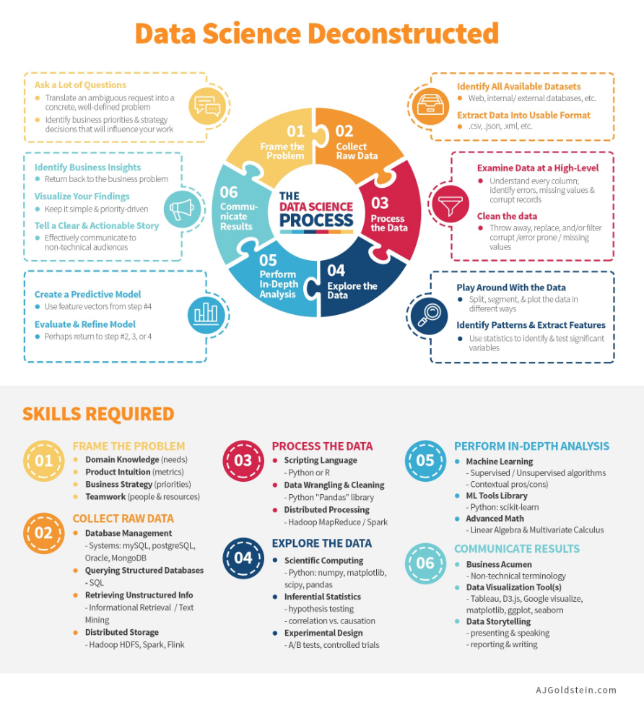

Slide 19
Course 2 Task 2
Problem:
Increase in customer default rates - This is bad for Credit One since we approve the customers for loans in the first place.
Revenue and customer loss for clients and, eventually, loss of clients for Credit One
Investigative Questions:
How do you ensure that customers can/will pay their loans? Can we do this?
As you progress through the tasks at hand, begin thinking about how to solve this problem. Here are some lessons we learned form a similar problem we addressed last year:
We cannot control customer spending habits
We cannot always go from what we find in our analysis to the underlying "why"
We must focus on the problem(s) we can solve: What attributes in the data can we deem to be statistically significant to the problem at hand?
What concrete information can we derive from the data we have?
What proven methods can we use to uncover more information and why?

Slide 20
What inferences can you make about the data after reviewing this describe() results?
Can you easily tell which features/variables are numeric or nominal?
In order to check the data types of each variable you can use the info() function of Pandas as follows:
credit.info()
From this point forward any related tasks should also be completed; some relevant examples are listed below, but you should already be familiar with what to do based on your previous experiences.
Data cleaning
Data transformation
How will you deal with missing values (if any)?
Data reduction
Data discretization
Text cleaning (if needed)
After thoroughly cleaning and preparing your data you will be ready to begin exploring it to gain further insight about the problem at hand and how you will use data science to solve it or at least gain a further understanding of it. When you feel like you've done everything that is needed to prepare the data for further analysis, you can move on to the next step, but you are encouraged to share your work with your mentor beforehand to ensure that you are ready to proceed.

Slide 21
Dealing with non-numeric data (One-Hot Encoding)
In the previous Classification task, you ensured you were working with all numeric data; however, typical datasets don’t contain only numeric values. Most data will contain a mixture of numeric and nominal data so we need to understand how to incorporate both when it comes to developing regression models and making predictions.
Categorical variables may be used directly as predictor or predicted variables in a multiple regression model as long as they've been converted to binary values. In order to pre-process the sales data as needed we first need to convert all object variables to binary features that contain ‘0’ and ‘1’ classes. Fortunately, pandas has a method for creating these 'Dummy Variables' as follows:
credit.dtypes
We can see we have three variables that are listed as being the object data type; we need to convert these to 'Dummy variables' so they can be used in this multiple regression problem.
Note: All of the variables we're converting are features; if the dependent variable also fell into this category, we'd need to use a different process called Label Encoding and you'll soon see why!

Slide 22
2. Now we can use the get_dummies() function within pandas to convert our non-numeric columns to a series of binary numeric 'Dummy' columns as follows:
credit = pd.get_dummies(credit)
Notice how this changed the Education variable (all of the 'object' columns were changed this way):
3. It is a good idea to double-check your dtypes at this point to make sure everything is now numeric as needed.

Slide 23
Credit One Report Course 2-Task 2
Alex Guevara

Slide 24
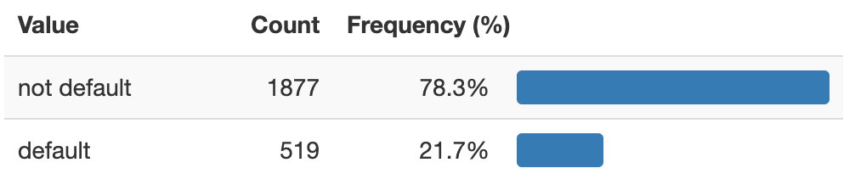
Default Status Frequencies
The percent of Defaulted Clients is nearly 22%, impacting loss of revenue and Credit One Clients
How can we decrease default rates and increase business opportunities for Credit One?

Slide 25
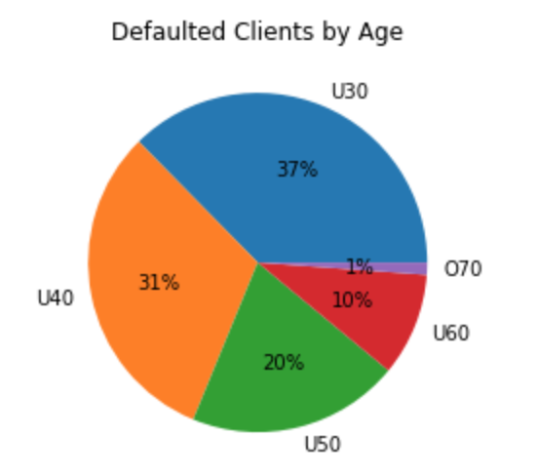
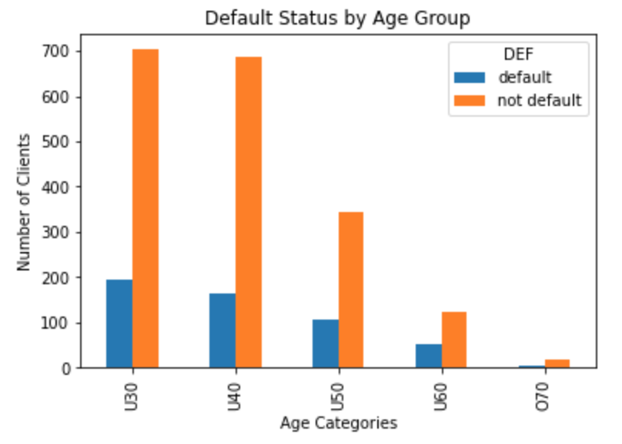
Default Status by Age
By Age Category, the Under 40 and Under 30 age groups encompass 68% of defaulted clients
The Under 30 and Under 40 age groups yield similar number of defaulted clients

Slide 26
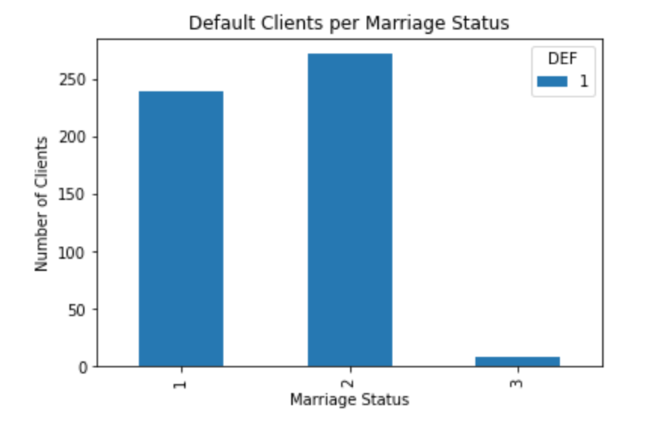
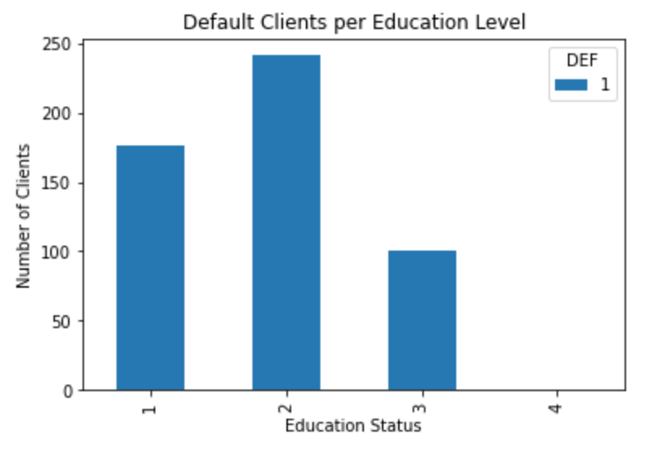
Default Client Trends
There are more defaulted Graduate School (1) and University (2) Clients than High School (3) Clients
There are more defaulted Married (1) and Single (2) Clients than Divorced (3) Clients

Slide 27
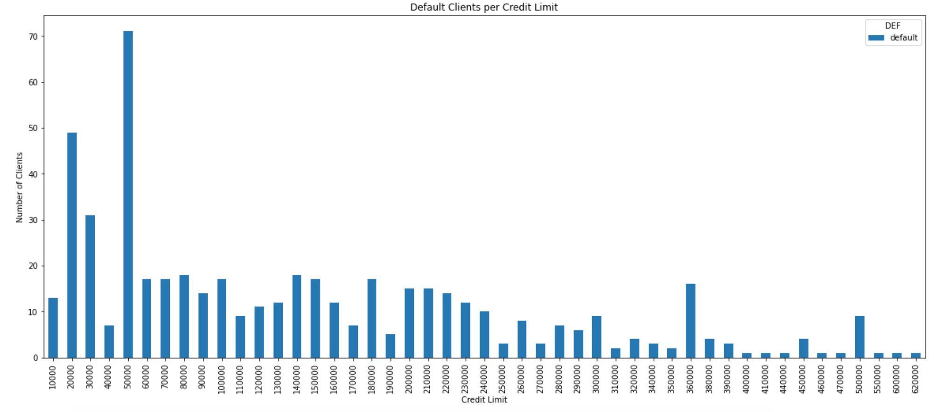
Defaulted Credit Limits
Mean | St Dev | Min | 25% | 50% | 75% | Max
$145K | $121K | $10K | $50K | $110K | $210K | $620K

Slide 28
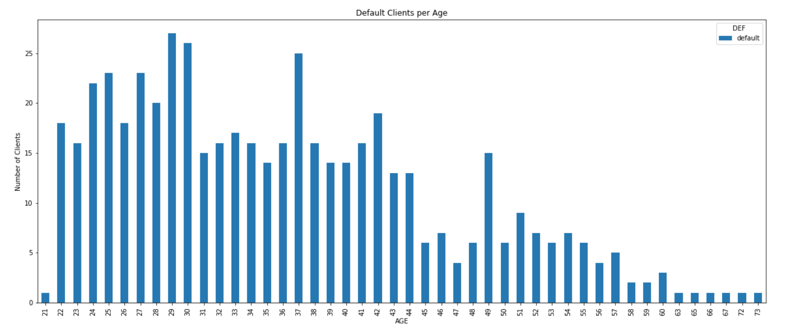
Default Clients by Age
Mean | St Dev | Min | 25% | 50% | 75% | Max
36 | 10 | 21 | 28 | 35 | 42 | 73

Slide 29
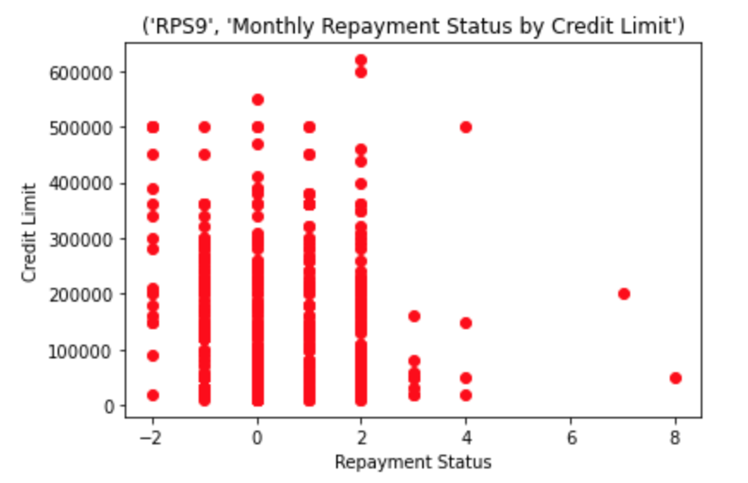
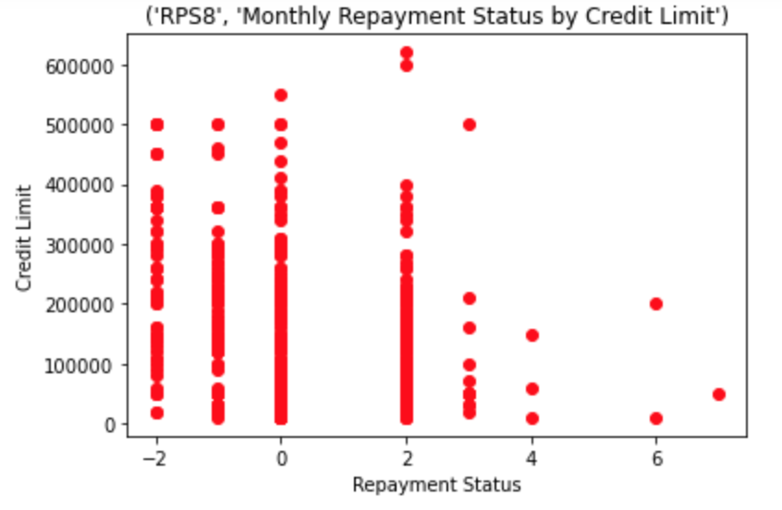
Default Client Repayment Status
Based on September and August Months
Lower credit limit default clients are taking longer to repay
Future Considerations
Re-analyze delayed payments in the 3rd and 4th quartile
RPS | Min | 25% | 50% | 75% | Max
September | -2 | 0 | 1 | 2 | 8
August | -2 | -1 | 0 | 2 | 7
July | -2 | -1 | 0 | 2 | 7
June | -2 | -1 | 0 | 0 | 7
May | -2 | -1 | 0 | 0 | 7
April | -2 | -1 | 0 | 0 | 8

Slide 30
Credit One Conclusions
Credit One potential business value from this analysis
Combined, 68% of defaulted clients are comprised of Under 40 and Under 30 age groups
It is difficult to discern default trends by Marriage or Education Status
Per Credit Limit, the average default credit limit was $145,000
The average age for defaulted clients is 36
There may be a trend of lower credit limit clients who take longer for repayment
Future Recommendations
Re-analyze delayed payments in the 3rd and 4th quartile
Determine any additional trends based on Age, Credit Limit, Repayment status,

